Slide 1
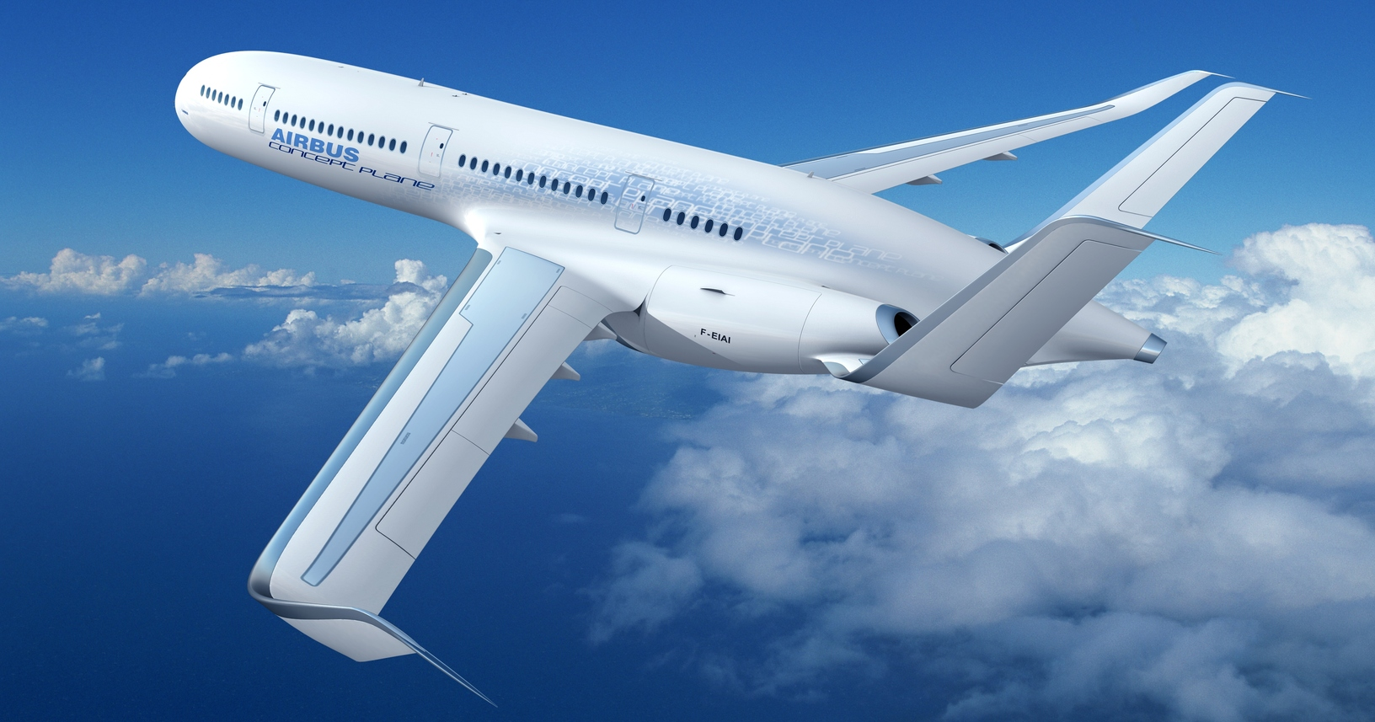




FLIGHT DATA
By : Aziz, Emil, and Walid
This Photo by Unknown Author is licensed under CC BY-ND
Sponsored by:

Slide 2
Introduction
Flight delay is a serious and widespread problem in the United States. Increasing flight delays place a significant strain on the US air travel system and cost airlines, passengers, and society many billions of dollars each year.
Our project analyzes flight data to understand flight delays and cancellation trends.
Most/Least busiest months of the year?
Airports with the most flight destinations?
Airlines with the most/least delays?
Departure Delays vs Days of week?
Data set :
Kaggle 2015 Flight Delays and Cancellations
The data was retrieved via SQL queries in Postgres SQL database

Slide 3
Summary
Most/least busiest months of year?
The two most busiest months of the year are July (520,718) and August (510,536) and the two least busiest are February (429,191) and September (464,946).
Why? This can be due to a combination of the holidays and summer time.
Airport with the most flight destinations?
Airport with the most flight destinations is the Atlanta International Airport by a good distance.
Why? It is a major connecting hub and a two-hour flight for 80% of the US population.

Slide 4
Summary
Airlines with most/least flight delays?
Our data shows that most of the delays occur on flights from big airlines such as Southwest Airlines, Delta, and American.
Least flight delays occur with Hawaiian Airlines and Virgin America.
Why? The bigger airlines run more trips and the smaller airlines like Virgin report their performance numbers to the Bureau of Infrastructure, Transport and Regional Economics (BITRE). This helps them track and monitor their efficiency.
Departure delays vs days of week?
The most delays happen on Mondays (1.0) and Sundays (7.0).
Why? Most people return from weekend travels on Sunday and Monday so it makes sense there would be the most delays on those days as most flights will be fully booked and the airport probably at it's busiest.

Slide 5
The end

